Slide 1
Introduction to Content Management Systems
Day 3

Slide 2

What is Drupal
Drupal is a free, open source content-management framework written in PHP and distributed under the GNU General Public License
Drupal provides a back-end framework for at least 2.2% of all Web sites worldwide (as of Nov. 2016)– ranging from personal blogs to corporate, political, and government sites. Systems also use Drupal for knowledge management and for business collaboration.
The standard release of Drupal, known as Drupal core, contains basic features common to content-management systems. These include user account registration and maintenance, menu management, RSS feeds, taxonomy, page layout customization, and system administration.
The Drupal core installation can serve as a simple Web site, a single- or multi-user blog, an Internet forum, or a community Web site providing for user-generated content.
As of November 2016 the Drupal community is composed of more than one million members, including 104,200 users actively contributing.
Drupal has more than 35,800 free modules that extend and customize Drupal functionality, over 2,300 free themes that change the look and feel of Drupal, and at least 1,050 free distributions that allow you to quickly and easily set up a complex, use-specific Drupal in fewer steps.

Slide 3
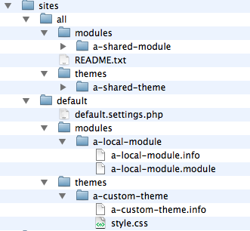
Main Properties of Drupal
Resources Management
Database, Files, Images
Configuration Management
Drupal is designed to make it easy to make changes, export site configuration to files, and import those changes back into the site. This allows your site's configuration to be stored as part of your site's codebase, and thus integrated in your version control system and your deployment process.
The active configuration is stored in the database.
Content Management (Taxonomy)
Taxonomy is the practice of classifying content;
The Taxonomy module allows you to create, manage and apply vocabularies (organizational keywords, also known as categories, tags, or metadata).

Slide 4
Rapid Application Development with Drupal
Entities and Nodes
Content Types
Modules (core and contributed)
Themes
Blocks
Menus
Roles and Permissions
Administration
Hooks and Callbacks
Form and other APIs

Slide 5
Exercise
Download and install Drupal from https://www.drupal.org/download
Installation Guide: https://www.drupal.org/docs/8/install
If you are installing on WAMP, detailed instructions for Drupal installation can be found at https://www.drupal.org/node/114493
Complete the “Getting Started with Drupal ” tutorial at https://www.tmdhosting.com/tutorials/drupal8/first-steps-in-drupal-8.html
Create an Article Page
Menu Management
Extend functionality with additional modules
Install a new theme

Slide 6
Exercise
Complete the Multi-step Form tutorial at https://www.sitepoint.com/how-to-build-multi-step-forms-in-drupal-8/
Test your Drupal site with multiple devices.
What differences did you notice between WordPress and Drupal development?

